Slide 1
JavaScript Debugging
[SPEAKER NAME]
Technical Evangelist
Microsoft

Slide 2
Agenda
Types of Errors in JavaScript
Frequent Locations of Errors in JavaScript
Debugging and Introspection Tools
Remote Debugging Node Processes
Remote Debugging Front-End JavaScript

Slide 3
About [SPEAKER]

Slide 4
Type and Locations of Errors in JavaScript

Slide 5
Types of Errors in JavaScript
Loading Errors
E.g. Incorrect syntax, minification errors, network-related errors, missing files, etc.
Runtime Errors
E.g. Syntax errors, misspelled variables, illegal assignment, variables/classes don’t exist, etc.
Logic Errors
E.g. BUGS! But also errors due to format and parameters (JSON vs XML), etc…

Slide 6
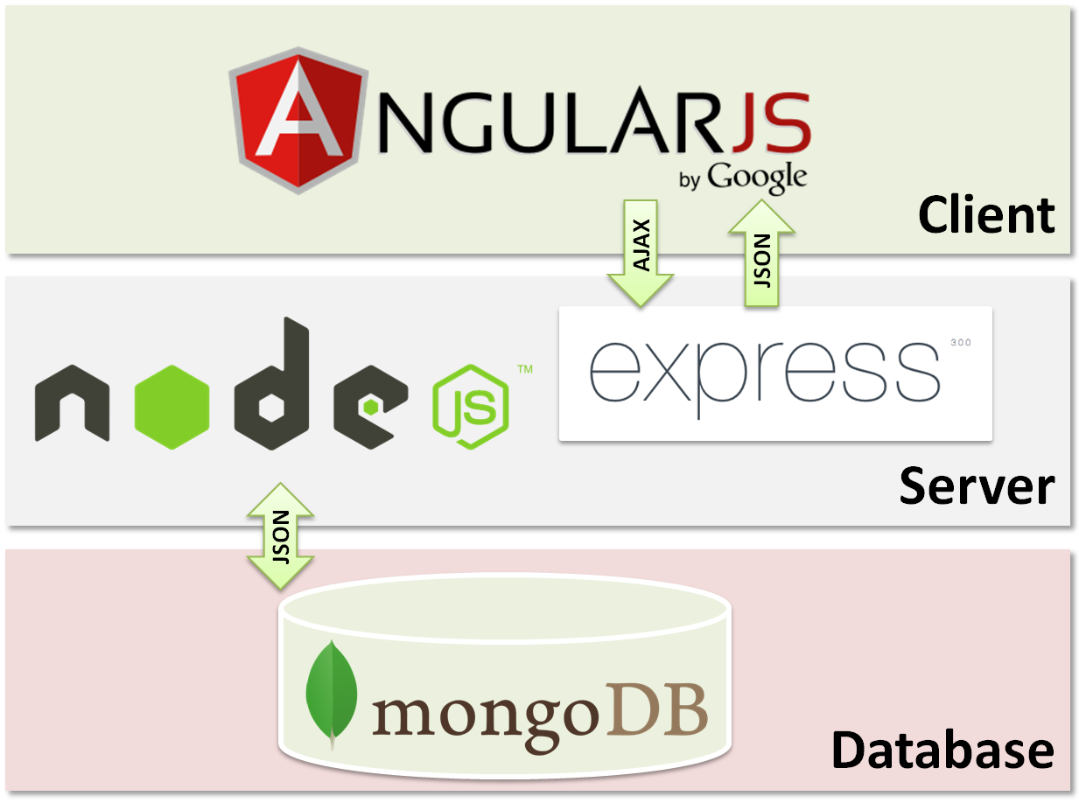
Locations of Errors in JavaScript
errors here
errors here
errors here

Slide 7
Debugging & Introspection Tools
With Demos.

Slide 8
Typical Logic Errors in JavaScript
Using this wrong an scoping errors
Accidentally creating memory leaks
Dangling references to unused objects
Circular references
Incorrect coercion, comparisons and equality
Incorrect references to instance objects & prototypical inheritance errors
So much more…

Slide 9
Debugging & Introspection Tools
Allow you to control execution and walk through line-by-line
Debug with breakpoints to conditionally stop execution
Examine the call stack
Pause on exceptions
Stack trace exceptions

Slide 10
Demo: F12 Introspection Tools
https://gist.github.com/sayar/3ffa68c1765b8e6d78e0
See Speaker Notes
Notes:
In the Gist on GitHub, you will find an HTML file that has a button you can click to generate a Memory Leak with jQuery. You can demo the F12 tools by hunting for the memory leak and identifying the line that causes it.

Slide 11
Debugging Node Apps – node-inspector
Node Inspector supports almost all of the debugging features of the Blink DevTools, including:
Set breakpoints (and specify trigger conditions)
Step over, step in, step out, resume (continue)
Inspect scopes, variables, object properties
Edit variables and object properties
CPU and HEAP profiling
Network client requests inspection

Slide 12
Debugging Node Apps – node-inspector
Other cool stuff:
Node Inspector uses WebSockets, so no polling for breaks.
Remote debugging
Live edit of running code, optionally persisting changes back to the file-system.
Set breakpoints in files that are not loaded into V8 yet - useful for debugging module loading/initialization.
Embeddable in other applications

Slide 13
Demo: Node-Inspector
npm install -g node-inspector
node-debug app.js

Slide 14
IDE Demo: Code
It’s free and runs on Linux/OSX/Windows.
See Speaker Notes.
Notes:
You want to demo the node.js debugging tools in Visual Studio Code here. You can generate a sample express app by using the express-generator npm module.

Slide 15
Not All Debugging Happens During Development…

Slide 16
You Can Debug Production Node Applications!
Debugging node applications is easy if you know you want to debug… It gets harder when you want to connect to already-running production applications…

Slide 17
Enabling Debugging on a Node Process
On OSX/Linux…
$ pgrep -l node
2345 node your/node/server.js
$ kill -s USR1 2345
On Windows…
> tasklist /FI “IMAGENAME eq node.exe”
> node -e “process._debugProcess(3084)”

Slide 18
Connecting to a Remote Node Process
With built-in node debugger:
$ node debug localhost:5858
With node-inspector:
$ node-inspector
With Visual Studio Code
Use Attach launch setting, debug… ☺

Slide 19
Demo: Debugging Remote Node Process

Slide 20
“your website doesn’t work on my pc”
Who hasn’t heard that one or a variant before?

Slide 21
Debugging JavaScript in Remote Browsers
Wait… what! You can do that?

Slide 22


Slide 23
Vorlon.JS
An open source, extensible, platform-agnostic tool for remotely debugging and testing your JavaScript.
Plugins:
Console: View logs and errors for your application.
Modernizr: View a list of supported and unsupported features.
DOM Explorer: Inspect the DOM tree and its corresponding styles.
Object Explorer: Display the living JavaScript variables tree.
XHR Panel: View XHR calls information sent by your devices.
ngInspector: Inspect your Angular.js scopes
Network Monitor: View network activities (XHR & resources loading).
Resources Explorer: Inspect local resources such as localStorage or cookoes.

Slide 24
Getting Started with Vorlon.JS
$ npm i -g vorlon
$ vorlon
Add to your code.
<script src="http://localhost:1337/vorlon.js"></script>
Open http://localhost:1337

Slide 25
Using Vorlon.JS to Remote Debug
Deploy Vorlon.JS to a public server/PaaS/wtv.
As simple as a git push
Add this to your public beta website:
<script src="http://mywebsite.com/vorlon.js"></script>

Slide 26
Other Tools: Vantage
Vantage = CLI + SSH + REPL for your live node app

Slide 27
Demo: Vantage
$ npm install -g vantage
$ vantage tour

Slide 28
What did we learn?
Types of Errors & Locations in JavaScript
Debugging and Introspection Tools
node-inspector
VS Code
Remote Debugging Node Processes
node-inspector, VS Code
Vantage
Remote Debugging Front-End JavaScript
Vorlon.JS

Slide 29
Thank You! Questions?
[ADD SPEAKER CONTACT HERE]

Slide 30
Resources, References, Links
http://www.toptal.com/javascript/10-most-common-javascript-mistakes
https://developers.google.com/web/tools/javascript/breakpoints/
http://www.w3schools.com/js/js_debugging.asp
http://www.webreference.com/programming/javascript/rg31/index.html
http://eloquentjavascript.net/08_error.html
http://www.pluralsight.com/courses/fixing-common-javascript-bugs
https://trackjs.com/
http://www.standardista.com/javascript/15-common-javascript-gotchas/

